Slide 1
Docker and its Architecture

Slide 2
What is Docker
Docker is a platform that helps developers to :
Build
Run
Test
Verify
Share

Slide 3
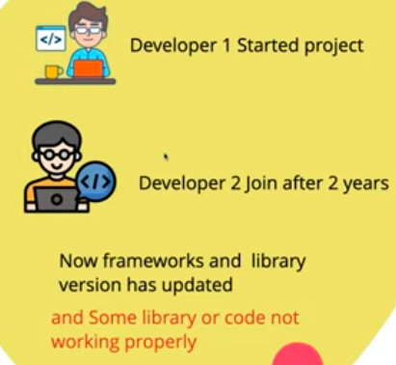
Need of Docker

Slide 4
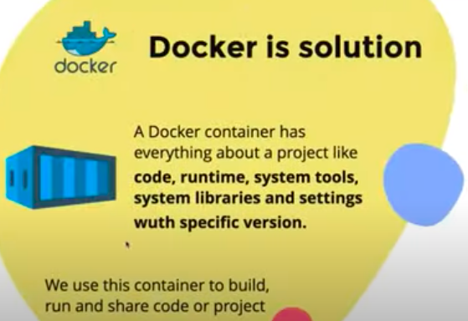

Slide 5
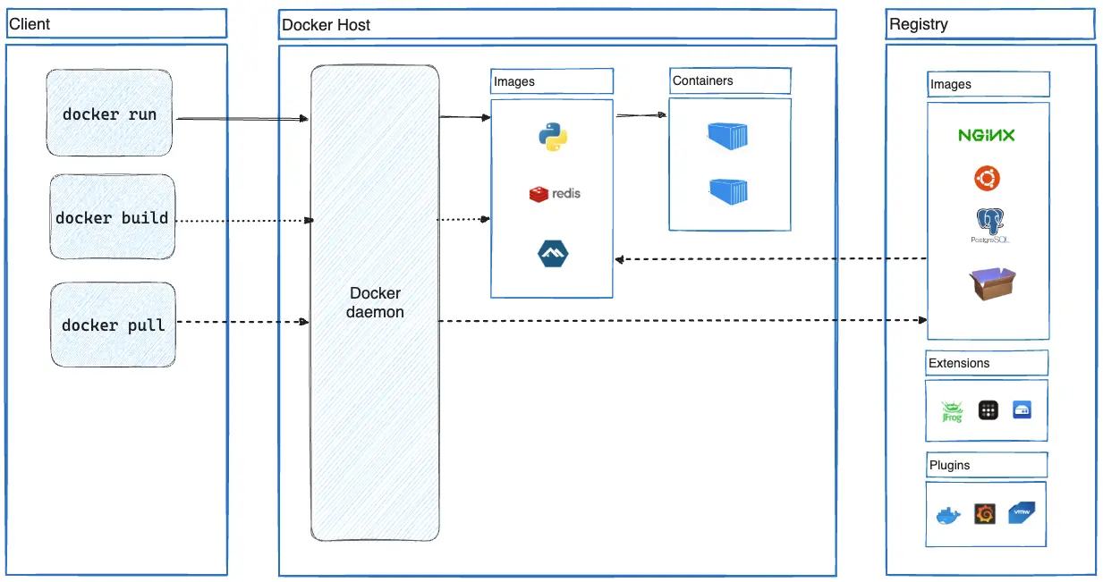
Architecture of Docker

Slide 6
Main Components of Docker :
The Docker daemon
The Docker client
Docker Host
Docker Desktop
Docker registries
Docker objects

